Slide 1
EXCS-BE-06
WIRELESS FIRE ALARM SYSTEM
Group Members :
Roll No | Name | Email ID | Mobile Number
20103B0031 | TEJAS BRID` | tejas.brid@vit.edu.in | 8369922997
20103B0049 | NAVDEEP PATIL | navdeep.patil@vit.edu.in | 8866557829
20103B0048 | SIDDHANT DETHE | siddhant.dethe@vit.edu.in | 7304203535
20103B0051 | SHREYAS TUKRUL | shreyas.tukrul@vit.edu.in | 8104099114
Under the Guidance of :
Prof. Amol Sakhalkar

Slide 2
Industry Expert with whom Project proposal is discussed
Name: Amol Sakhalkar
Designation: Guide in-charge
Email: amol.sakhalkar@vit.edu.in
Mobile number: 9820632790

Slide 3
Introduction
Our project of Wireless Fire Safety Alarm transmits the signal wirelessly with the aid of nRF module thereby reducing the risks involved in physical detection of fire, wire cutting & time consumption

Slide 4
Usefulness of the Project
Important in safety of system.
Easier installing process.
Flexible and expandable.
Remote monitorization.
Cost effective.
Failure of one node does not affect other.

Slide 5
Social impact of the Project
Improved security.
Faster response.
Property Protection.
Reduced false alarms.
Environmental impact

Slide 6
Objectives defined for the project
1. Reliable Fire Detection To create and build a system for accurately detecting fire incidents utilizing appropriate sensors such as temperature sensors and smoke detectors.
2. Wireless Communication To create a dependable wireless network between fire sensors and a central hub by utilizing nRF modules for data transfer.
3. Triggering Fast Alarms To reduce response time by guaranteeing effective data processing and prompt alarm activation at the central hub upon fire detection
. 4. Enhancing Situational Awareness To create features that offer real-time information on fire location and severity, potentially integrating with existing building management systems.
5. Low Power Consumption To optimize system design to reduce the power consumption of nRF modules and fire sensors, assuring longer battery life.
6. Cost Effectiveness To use cost-effective components and nRF modules to design a fire alarmsystem that is both accessible and economical for a variety of deployment scenarios.

Slide 7
Resources Needed (Hardware and Software)
Hardware components
Microcontroller – Arduino Uno
NRF24LO1
Small Buzzer
Li ion batteries
TP4056
MQ2 Smoke Sensor Module
16x2 LCD Display with I2C interface – Blue

Slide 8
Block Diagram
Power Supply
(3.7V Li-ion Batteries X2)
Smoke Sensor
(MQ2)
Microcontroller Development Board
(Arduino Nano)
WiFi Module
(nRF24 L01)
Transmitter Node with Smoke Detector

Slide 9
Block Diagram
Power Supply
(3.7V Li-ion Batteries X2)
Microcontroller Development Board
(Arduino Nano)
WiFi Module
(nRF24 L01)
Hopper Node

Slide 10
Block Diagram
Power Supply
(3.7V Li-ion Batteries X2)
Alarm
(Piezoelectric Buzzer)
Microcontroller Development Board
(Arduino Nano)
Display
(16x2 LCD)
Display Node

Slide 11
Block Diagram
Transmitter Node
At Location 1
Transmitter Node
At Location 2
Wireless communication
Hopper Node
Hopper Node
Display Node

Slide 12
Methodology
In this system the arduinos are connected to each other through NRF24L01.
The nodes are connected in a tree structure with one node as base node.
The connection does not break even if one of the nodes fail or gets damaged.
The system then alerts through a buzzer and shows the node at which emergency is required.

Slide 13
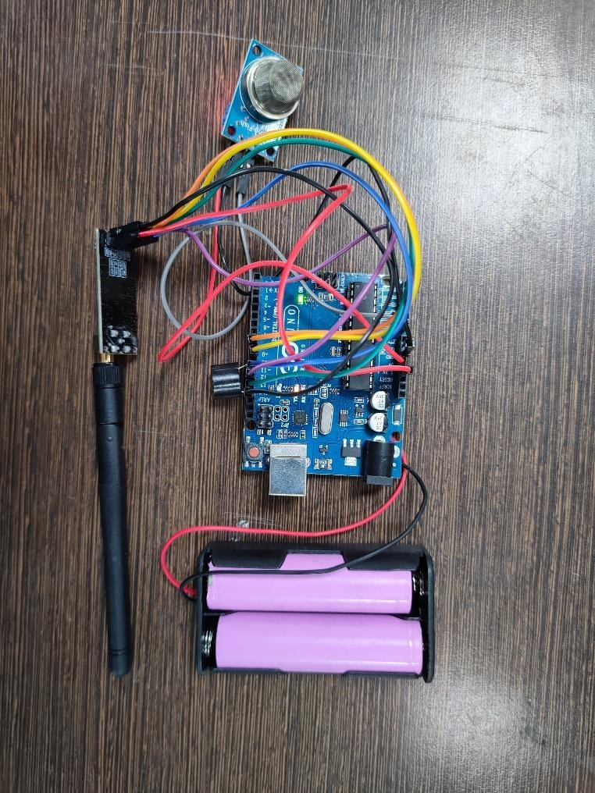
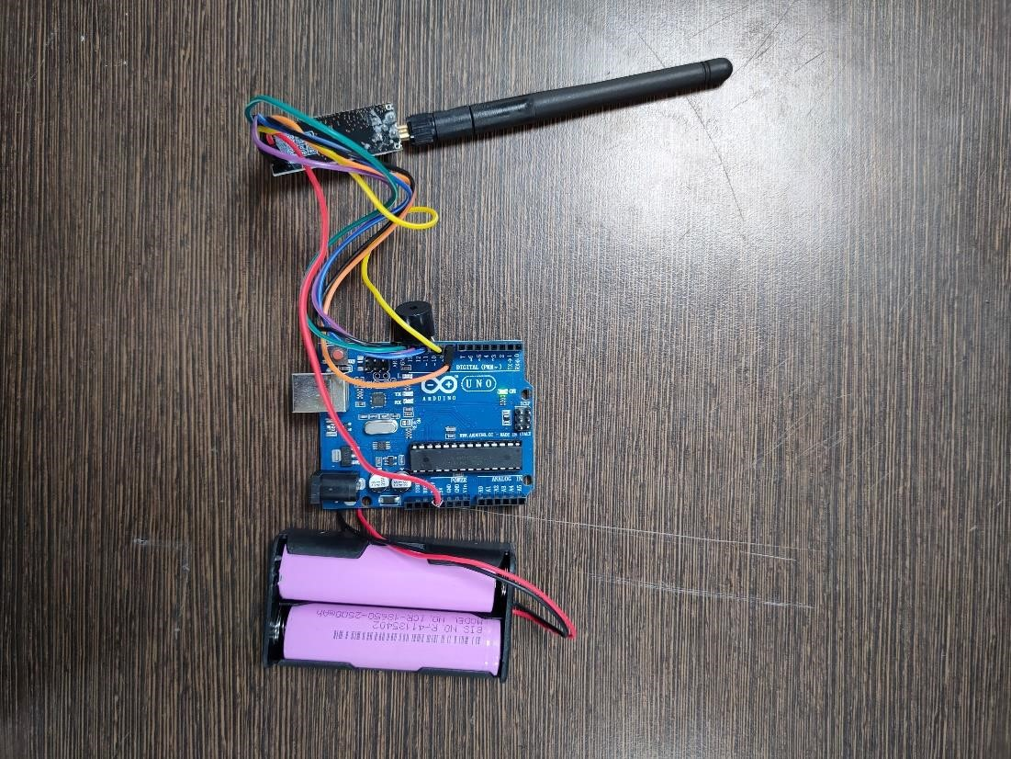
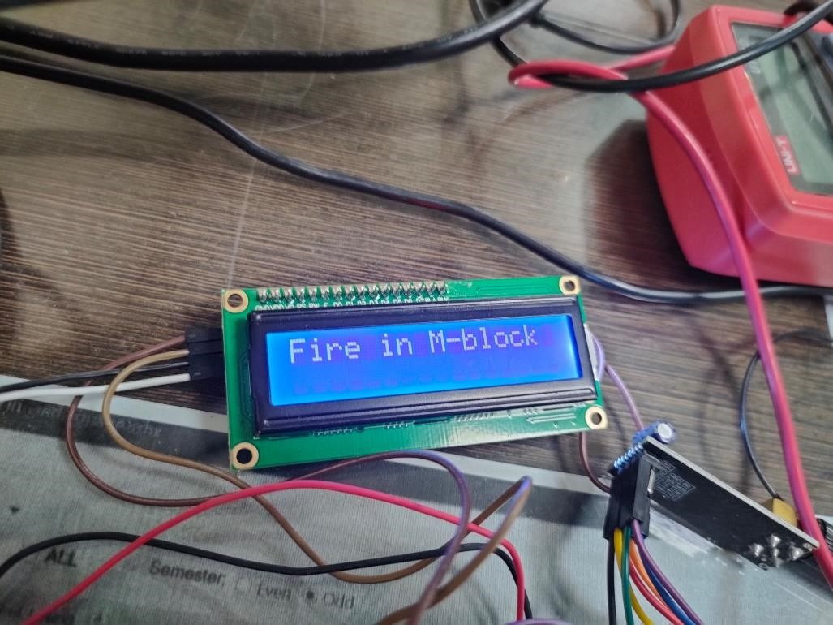
RESULTS
Smoke Detector Node
Hopper Node
Control Panel

Slide 14

Project Cost
Sr. No. | Component | No. of Units | Cost (INR)
1. | Arduino Uno | 5 | 2100
2. | NRF24LO1 with antenna | 5 | 725
3. | Small Buzzer | 5 | 75
4. | Li ion batteries | 10 | 750
5. | TP4056 | 1 | 45
6. | Double battery sockets | 5 | 150
7. | Uno programming cable | 2 | 80
8. | Female – Male Jumper wires | 25 | 200
9. | MQ2 Smoke Sensor Module | 2 | 160
10. | 16 x 2 LCD Display with I2C interface - Blue | 1 | 100
11. | Acrylic sheet (3 x 5 inches) | 3 | 350
 | Total |  | 4,535

Slide 15
Conclusion
📌
This project showcases a wireless fire safety system based on the Arduino Uno microcontroller, the NRF24L01 radio module, the TP4056 battery charger, and the MQ-2 smoke sensor module. The central processing unit is the Arduino Uno, which reads data from the smoke sensor and sounds an alert if a fire is detected. The NRF24L01 allows for wireless communication across numerous systems, resulting in a scalable network of sensors across a building or complex

Slide 16
References
📖
https://howtomechatronics.com
https://www.Arduino.cc
https://components101.com/wireless/nrf24l01-pinout-features-datasheet
https://components101.com/microcontrollers/arduino-uno
https://www.nordicsemi.com/Products/Technologies/Security

Slide 17
THANKS!

